Slide 1
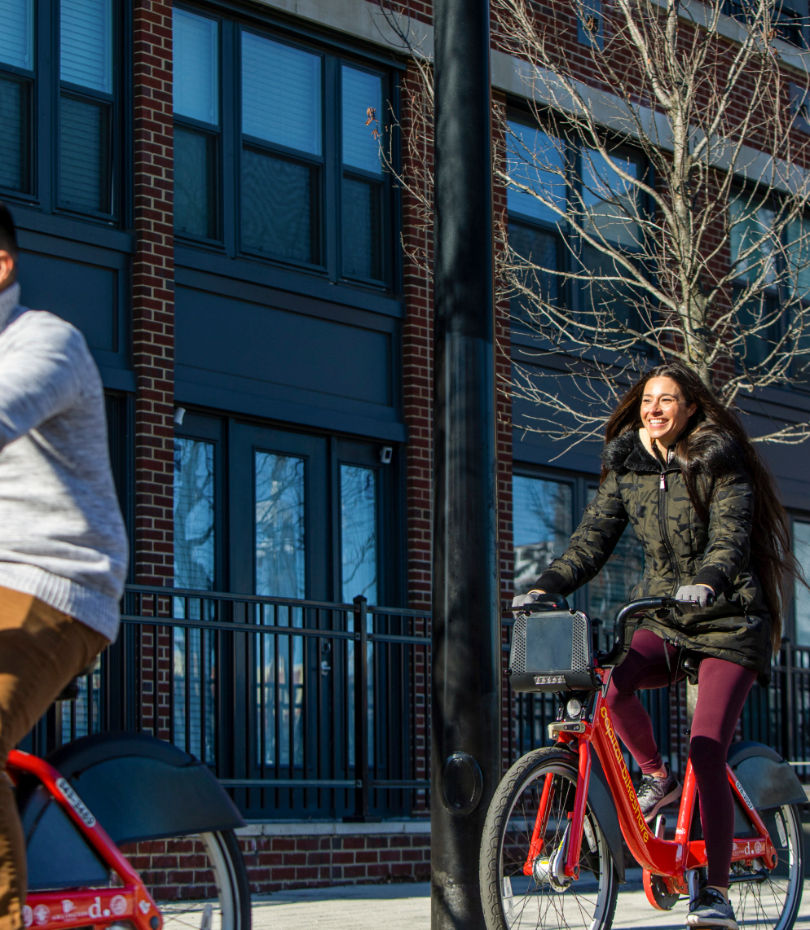
CYCLISTIC CASE STUDY
By GARV GULATI

Slide 2
CONTENTS
Introduction
Timeline
Areas of growth
Primary goals
Summary
Presentation Title

Slide 3

INTRODUCTION
In this case study, you work for a fictional company, Cyclistic, along with some key team members. In order to answer the business questions, follow the steps of the data analysis process: Ask, Prepare, Process, Analyze, Share, and Act. Along the way, the Case Study Roadmap tables — including guiding questions and key tasks — will help you stay on the right path.

Slide 4
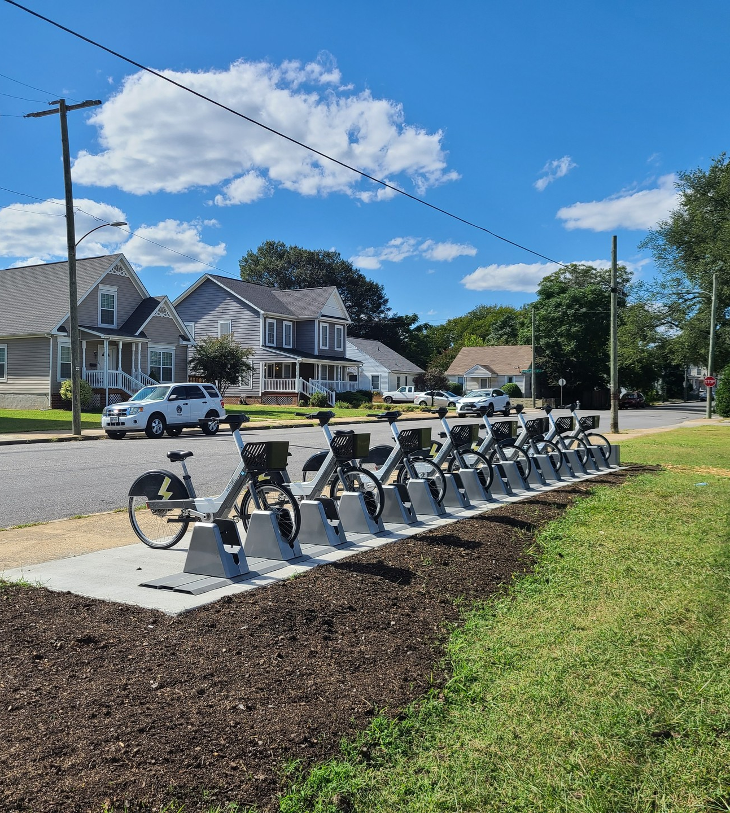
SCENARIO
You are a junior data analyst working on the marketing analyst team at Cyclistic, a bike-share company in Chicago. The director of marketing believes the company’s future success depends on maximizing the number of annual memberships.
Therefore, your team wants to understand how casual riders and annual members use Cyclistic bikes differently. From these insights, your team will design a new marketing strategy to convert casual riders into annual members.
But first, Cyclistic executives must approve your recommendations, so they must be backed up with compelling data insights and professional data visualizations.

Slide 5
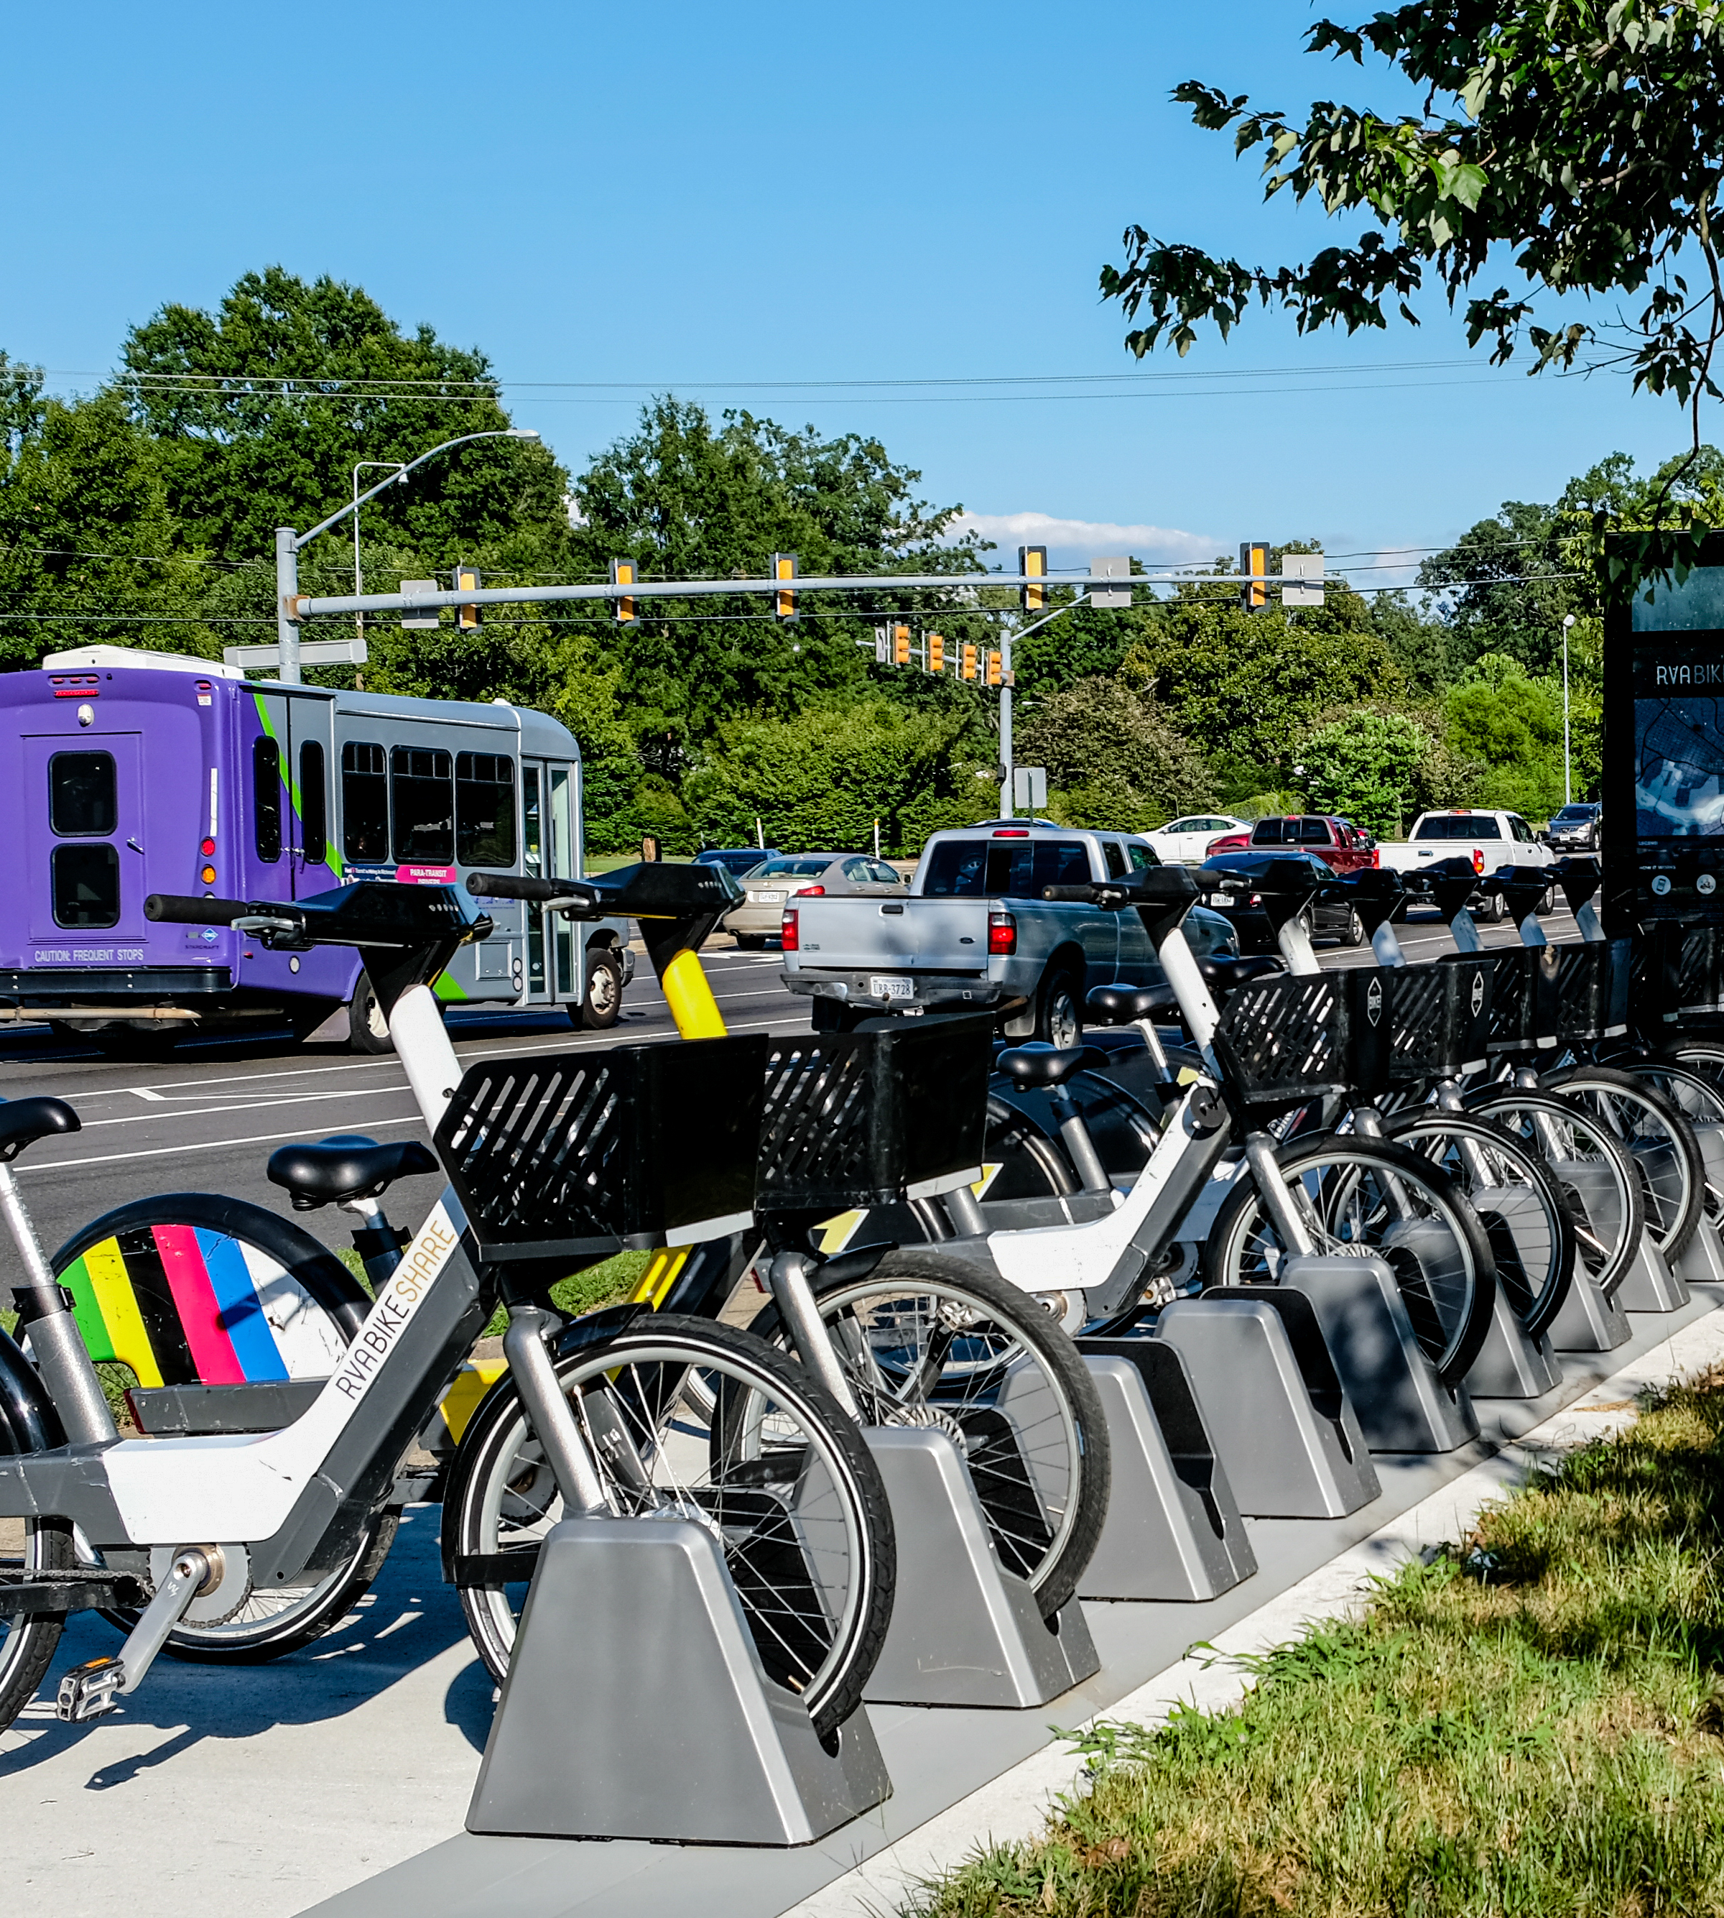
TIMELINE
In 2016, Cyclistic launched a successful bike-share offering. Since then, the program has grown to a fleet of 5,824 bicycles that are geo-tracked and locked into a network of 692 stations across Chicago. The bikes can be unlocked from one station and returned to any other station in the system anytime. Until now, Cyclistic’s marketing strategy relied on building general awareness and appealing to broad consumer segments. One approach that helped make these things possible was the flexibility of its pricing plans: single-ride passes, full-day passes, and annual memberships.
Customers who purchase single-ride or full-day passes are referred to as casual riders. Customers who purchase annual memberships are Cyclistic members. Cyclistic’s finance analysts have concluded that annual members are much more profitable than casual riders. Although the pricing flexibility helps Cyclistic attract more customers, Moreno believes that maximizing the number of annual members will be key to future growth.
Rather than creating a marketing campaign that targets all-new customers, Moreno believes there is a solid opportunity to convert casual riders into members. She notes that casual riders are already aware of the Cyclistic program and have chosen Cyclistic for their mobility needs. Moreno has set a clear goal: Design marketing strategies aimed at converting casual riders into annual members. In order to do that, however, the team needs to better understand how annual members and casual riders differ, why casual riders would buy a membership, and how digital media could affect their marketing tactics. Moreno and her team are interested in analyzing the Cyclistic historical bike trip data to identify trends.

Slide 6


PRIMARY GOALS
How do annual members and casual riders use Cyclistic bikes differently?
Why would casual riders buy Cyclistic annual memberships?

Slide 7
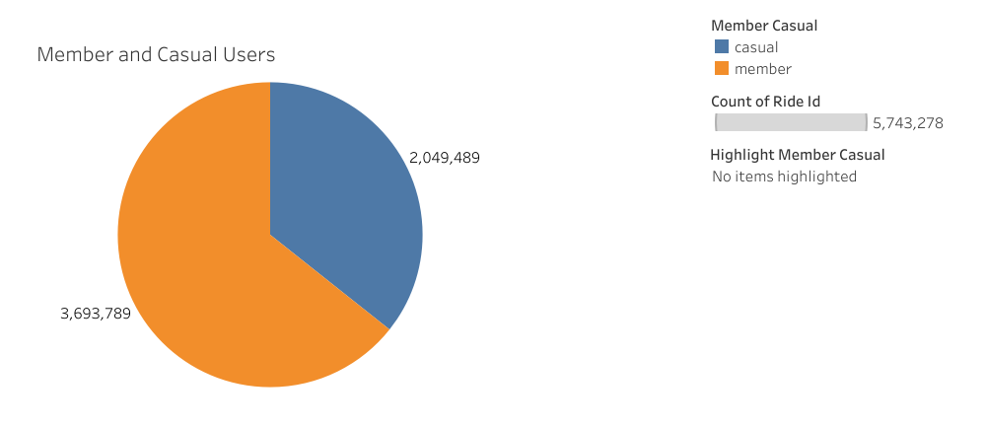
MEMBER V/S CASUAL RIDERS (Jun 2023 – May 2024) Total Riders – 5,743,278

Slide 8
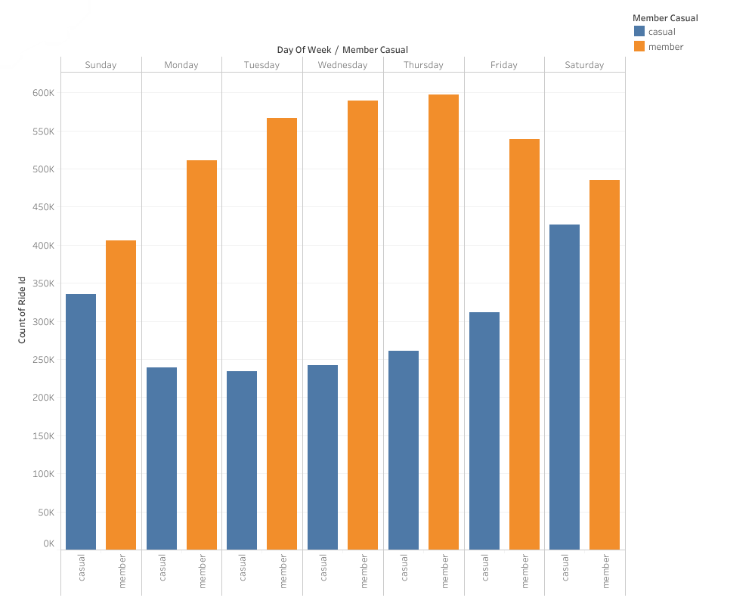
WEEKLY PERFORMANCE
Casuals ride more on the weekend
Members ride more during the week

Slide 9
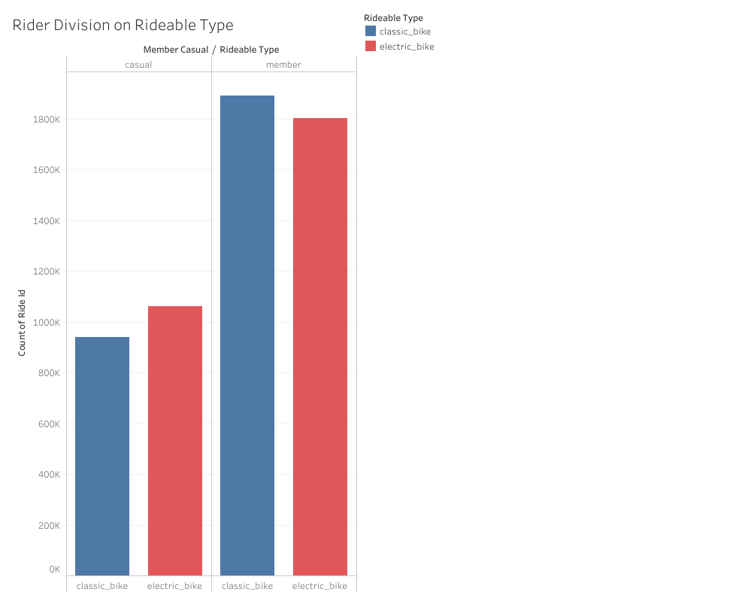
RIDEABLE TYPE

Slide 10
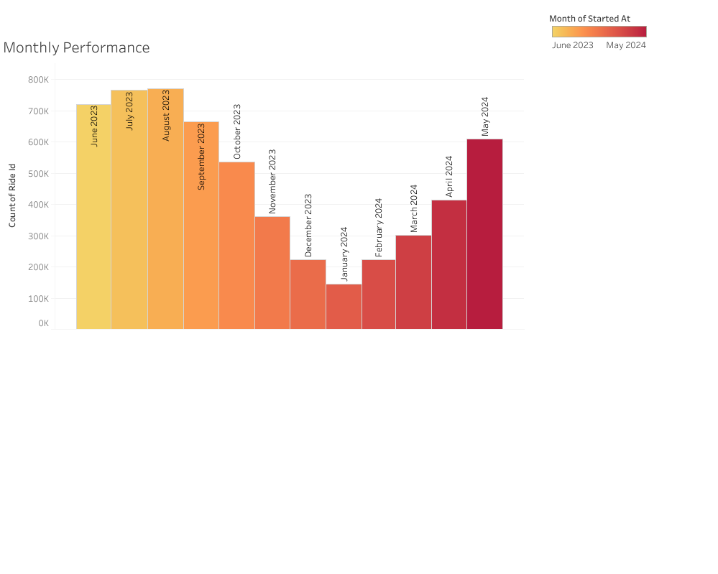
MONTHLY PERFORMANCE
Monthly Riders
Busiest Month – August 2023 (771,693)
Slowest Month – January 2024 (144,873)

Slide 11

INSIGHTS
Both ride more during Summer months
Both have similar Start and End Times
Members
Casuals
Ride more during the week
On average have shorter ride durations
Ride more on weekends
On average have longer ride durations

Slide 12


SUGGESTIONS
Option 1
Make annual memberships include unlimited 3-hour rides, instead of unlimited 45 minutes
Option 2
Create tiers for membership, includes annual benefits only on weekends

Slide 13




Thank you
Garv Gulati
gulati.garv03@gmail.com
www.linkedin.com/in/garvgulati

